Slide 1
Descriptive Statistics
Dr. Pradeep Bilurkar
Notes:
This template can be used as a starter file for presenting training materials in a group setting.
Sections
Right-click on a slide to add sections. Sections can help to organize your slides or facilitate collaboration between multiple authors.
Notes
Use the Notes section for delivery notes or to provide additional details for the audience. View these notes in Presentation View during your presentation.
Keep in mind the font size (important for accessibility, visibility, videotaping, and online production)
Coordinated colors
Pay particular attention to the graphs, charts, and text boxes.
Consider that attendees will print in black and white or grayscale. Run a test print to make sure your colors work when printed in pure black and white and grayscale.
Graphics, tables, and graphs
Keep it simple: If possible, use consistent, non-distracting styles and colors.
Label all graphs and tables.

Slide 2
Definition
Statistics is the science of collecting,
organizing, summarising, analysing,
and making inference from data
Descriptive stat. Includes
collecting, organizing,
summarising, analysing,
and presenting data
Inferential stat. Includes
Making inferences,
hypothesis testing
Determining relationship,
and making prediction
Notes:
There are two broad areas in statistics :descriptive and inferential stat.

Slide 3
Sample vs. Population
Population
Sample

Slide 4
Descriptive Statistics
An Illustration:
Which Group is Smarter?
Class A--IQs of 13 Students
102 115
128 109
131 89
98 106
140 119
93 97
110
Class B--IQs of 13 Students
127 162
131 103
96 111
80 109
93 87
120 105
109
Each individual may be different. If you try to understand a group by remembering the qualities of each member, you become overwhelmed and fail to understand the group.

Slide 5
Descriptive Statistics
Which group is smarter now?
Class A--Average IQ Class B--Average IQ
110.54 110.23
They’re roughly the same!
With a summary descriptive statistic, it is much easier to answer our question.

Slide 6
Descriptive Statistics
Types of descriptive statistics:
Organize Data
Tables
Graphs
Summarize Data
Central Tendency
Variation

Slide 7
Descriptive Statistics
Types of descriptive statistics:
Organize Data
Tables
Frequency Distributions
Relative Frequency Distributions
Graphs
Bar Chart or Histogram
Stem and Leaf Plot
Frequency Polygon

Slide 8
Descriptive Statistics
Summarizing Data:
Central Tendency (or Groups’ “Middle Values”)
Mean
Median
Mode
Variation (or Summary of Differences Within Groups)
Range
Interquartile Range
Variance
Standard Deviation

Slide 9
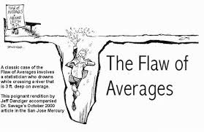
Mean
Most commonly called the “average.”
Add up the values for each case and divide by the total number of cases.
Y-bar = (Y1 + Y2 + . . . + Yn)
n
Y-bar = Σ Yi
n

Slide 10
Mean
Class A--IQs of 13 Students
102 115
128 109
131 89
98 106
140 119
93 97
110
Class B--IQs of 13 Students
127 162
131 103
96 111
80 109
93 87
120 105
109
Σ Yi = 1437 Σ Yi = 1433
Y-bar_{A} = Σ Yi = 1437 = 110.54 Y-bar_{B} = Σ Yi = 1433 = 110.23
n 13 n 13

Slide 11
Mean
The mean is the “balance point.”
Each person’s score is like 1 pound placed at the score’s position on a see-saw. Below, on a 200 cm see-saw, the mean equals 110, the place on the see-saw where a fulcrum finds balance:
1 lb at 93 cm
1 lb at 106 cm
1 lb at 131 cm
110 cm
17 units below
21 units above
4 units below
0 units
The scale is balanced because…
17 + 4 on the left = 21 on the right

Slide 12
Mean
Means can be badly affected by outliers (data points with extreme values unlike the rest)
Outliers can make the mean a bad measure of central tendency or common experience
Income in the U.S.
Bill Gates
All of Us
Mean
Outlier

Slide 13
Median
The middle value when a variable’s values are ranked in order; the point that divides a distribution into two equal halves.
When data are listed in order, the median is the point at which 50% of the cases are above and 50% below it.
The 50th percentile
Class A--IQs of 13 Students
89
93
97
98
102
106
109
110
115
119
128
131
140
Median = 109
(six cases above, six below)

Slide 14
Median
The median is unaffected by outliers, making it a better measure of central tendency, better describing the “typical person” than the mean when data are skewed.
Bill Gates
outlier
All of Us

Slide 15
Median
If the recorded values for a variable form a symmetric distribution, the median and mean are identical.
In skewed data, the mean lies further toward the skew than the median.
Symmetric
Skewed
Mean
Mean
Median
Median

Slide 16
Mode
The most common data point is called the mode.
The combined IQ scores for Classes A & B:
80 87 89 93 93 96 97 98 102 103 105 106 109 109 109 110 111 115 119 120
127 128 131 131 140 162
BTW, It is possible to have more than one mode!
It may mot be at the center of a distribution.
Data distribution on the right is “bimodal”

Slide 17
Mode
It may give you the most likely experience rather than the “typical” or “central” experience.
In symmetric distributions, the mean, median, and mode are the same.
In skewed data, the mean and median lie further toward the skew than the mode.
Symmetric
Skewed
Mean
Median
Mode
Mode
Median
Mean

Slide 18
Descriptive Statistics
Summarizing Data:
Central Tendency (or Groups’ “Middle Values”)
Mean
Median
Mode
Variation (or Summary of Differences Within Groups)
Range
Interquartile Range
Variance
Standard Deviation

Slide 19
Range
The spread, or the distance, between the lowest and highest values of a variable.
To get the range for a variable, you subtract its lowest value from its highest value.
Class A--IQs of 13 Students
102 115
128 109
131 89
98 106
140 119
93 97
110
Class A Range = 140 - 89 = 51
Class B--IQs of 13 Students
127 162
131 103
96 111
80 109
93 87
120 105
109
Class B Range = 162 - 80 = 82

Slide 20
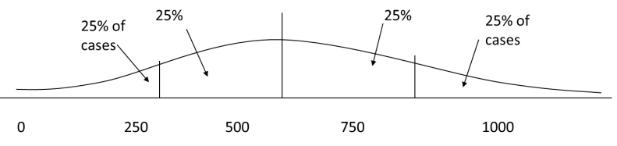
Interquartile Range
A quartile is the value that marks one of the divisions that breaks a series of values into four equal parts.
The median is a quartile and divides the cases in half.
25th percentile is a quartile that divides the first ¼ of cases from the latter ¾.
75th percentile is a quartile that divides the first ¾ of cases from the latter ¼.
The interquartile range is the distance or range between the 25th percentile and the 75th percentile. Below, what is the interquartile range?

Slide 21
Variance
A measure of the spread of the recorded values on a variable. A measure of dispersion.
The larger the variance, the further the individual cases are from the mean.
The smaller the variance, the closer the individual scores are to the mean.
Mean
Mean

Slide 22
Variance
Variance is a number that at first seems complex to calculate.
Calculating variance starts with a “deviation.”
A deviation is the distance away from the mean of a case’s score.
Yi – Y-bar
If the average person’s car costs $20,000, my deviation from the mean is - $14,000!
6K - 20K = -14K

Slide 23
Variance
The deviation of 102 from 110.54 is? Deviation of 115?
Class A--IQs of 13 Students
102 115
128 109
131 89
98 106
140 119
93 97
110
Y-bar_{A} = 110.54

Slide 24
Variance
The deviation of 102 from 110.54 is? Deviation of 115?
102 - 110.54 = -8.54 115 - 110.54 = 4.46
Class A--IQs of 13 Students
102 115
128 109
131 89
98 106
140 119
93 97
110
Y-bar_{A} = 110.54

Slide 25
Variance
We want to add these to get total deviations, but if we were to do that, we would get zero every time. Why?
We need a way to eliminate negative signs.
Squaring the deviations will eliminate negative signs...
A Deviation Squared: (Yi – Y-bar)
Back to the IQ example,
A deviation squared for 102 is: of 115:
(102 - 110.54)² = (-8.54)² ⁼ 72.93 (115 - 110.54)² = (4.46)² = 19.89
If you were to add all the squared deviations together, you’d get what we call the
“Sum of Squares.”
Sum of Squares (SS) = Σ (Yi – Y-bar)²
SS = (Y1 – Y-bar)² + (Y2 – Y-bar)² + . . . + (Yn – Y-bar)²

Slide 26
Variance
Class A--IQs of 13 Students
102 115
128 109
131 89
98 106
140 119
93 97
110
Y-bar = 110.54
Class A, sum of squares:
(102 – 110.54)² + (115 – 110.54)² +
(126 – 110.54)² + (109 – 110.54)² +
(131 – 110.54)² + (89 – 110.54)² +
(98 – 110.54)² + (106 – 110.54)² +
(140 – 110.54)² + (119 – 110.54)² +
(93 – 110.54)² + (97 – 110.54)² +
(110 – 110.54)
= SS
= 2825.39

Slide 27
Variance
The last step…
The approximate average sum of squares is the variance.
SS/N = Variance for a population.
SS/n-1 = Variance for a sample.
Variance = Σ(Yi – Y-bar)² / n – 1

Slide 28
Variance
For Class A, Variance = 2825.39 / n - 1
= 2825.39 / 12 = 235.45
How helpful is that???

Slide 29

Standard Deviation
To convert variance into something of meaning, let’s create standard deviation.
The square root of the variance reveals the average deviation of the observations from the mean.
Std Dev =
SQRT( )
For Class A, the standard deviation is: sqrt(235.45) = 15.34
The average of persons’ deviation from the mean IQ of 110.54 is 15.34 IQ points.
Larger std deviation means greater amounts of variation around the mean.
Std Dev. = 0 only when all values are the same (only when you have a constant and not a “variable”)
If you were to “rescale” a variable, the Std Dev would change by the same magnitude—if we changed units above so the mean equaled 250, the Std Dev on the left would be 30, and on the right, 60
Like the mean, the Std Dev will be inflated by an outlier case value.

Slide 30
Descriptive Statistics
Summarizing Data:
Central Tendency (or Groups’ “Middle Values”)
Mean
Median
Mode
Variation (or Summary of Differences Within Groups)
Range
Interquartile Range
Variance
Standard Deviation
…Wait! There’s more

Slide 31
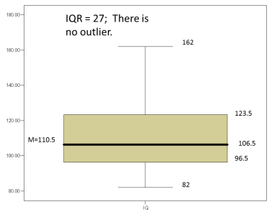
Box-Plots
A way to graphically portray almost all the descriptive statistics at once is the box-plot.
A box-plot shows: Upper and lower quartiles
Mean
Median
Range
Outliers (1.5 IQR)

Slide 32
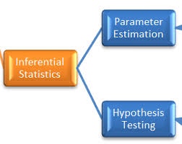

Slide 33
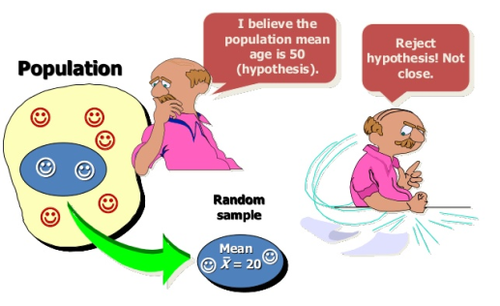
Hypothesis test
A hypothesis test is a statistical test that is used to determine whether there is enough evidence in a sample of data to infer that a certain condition is true for the entire population. A hypothesis test examines two opposing hypotheses about a population: the null hypothesis and the alternative hypothesis.

Slide 34
A statistical hypothesis
A statistical hypothesis is an assumption about a population parameter. This assumption may or may not be true. Hypothesis testing refers to the formal procedures used by statisticians to accept or reject statistical hypotheses.
The best way to determine whether a statistical hypothesis is true would be to examine the entire population. Since that is often impractical, researchers typically examine a random sample from the population. If sample data are not consistent with the statistical hypothesis, the hypothesis is rejected.
There are two types of statistical hypotheses.
Null hypothesis. The null hypothesis, denoted by H₀, is usually the hypothesis that sample observations result purely from chance.
Alternative hypothesis. The alternative hypothesis, denoted by H₁ or H_{a}, is the hypothesis that sample observations are influenced by some non-random cause.

Slide 35

A Statistical Hypothesis
For example, suppose we wanted to determine whether a coin was fair and balanced.
A null hypothesis might be that half the flips would result in Heads and half, in Tails.
The alternative hypothesis might be that the number of Heads and Tails would be very different. Symbolically, these hypotheses would be expressed as
H0: P = 0.5
Ha: P ≠ 0.5.
Suppose we flipped the coin 50 times, resulting in 40 Heads and 10 Tails. Given this result, we would be inclined to reject the null hypothesis. We would conclude, based on the evidence, that the coin was probably not fair and balanced

Slide 36
A Statistical Hypothesis
Can We Accept the Null Hypothesis?
Some researchers say that a hypothesis test can have one of two outcomes: you accept the null hypothesis or you reject the null hypothesis. Many statisticians, however, take issue with the notion of "accepting the null hypothesis." Instead, they say: you reject the null hypothesis or you fail to reject the null hypothesis.
Why the distinction between "acceptance" and "failure to reject?" Acceptance implies that the null hypothesis is true. Failure to reject implies that the data are not sufficiently persuasive for us to prefer the alternative hypothesis over the null hypothesis.

Slide 37
Hypothesis Tests
This process, called hypothesis testing, consists of four steps.
State the hypotheses. This involves stating the null and alternative hypotheses. The hypotheses are stated in such a way that they are mutually exclusive. That is, if one is true, the other must be false.
Formulate an analysis plan. The analysis plan describes how to use sample data to evaluate the null hypothesis. The evaluation often focuses around a single test statistic.
Analyze sample data. Find the value of the test statistic (mean score, proportion, t statistic, z-score, etc.) described in the analysis plan.
Interpret results. Apply the decision rule described in the analysis plan. If the value of the test statistic is unlikely, based on the null hypothesis, reject the null hypothesis.

Slide 38
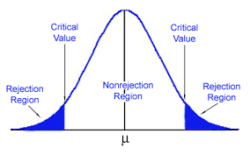
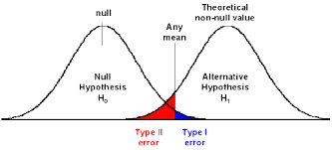
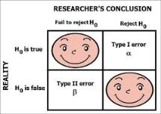
Decision Errors
Two types of errors can result from a hypothesis test.
Type I error. A Type I error occurs when the researcher rejects a null hypothesis when it is true. The probability of committing a Type I error is called the significance level. This probability is also called alpha, and is often denoted by α.
Type II error. A Type II error occurs when the researcher fails to reject a null hypothesis that is false. The probability of committing a Type II error is called Beta, and is often denoted by β. The probability of not committing a Type II error is called the Power of the test.

Slide 39
Decision Rules
The analysis plan includes decision rules for rejecting the null hypothesis. In practice, statisticians describe these decision rules in two ways - with reference to a P-value or with reference to a region of acceptance.
P-value. The strength of evidence in support of a null hypothesis is measured by the P-value. Suppose the test statistic is equal to S.
The P-value is the probability of observing a test statistic as extreme as S, assuming the null hypotheis is true.
If the P-value is less than the significance level, we reject the null hypothesis.
Region of acceptance. The region of acceptance is a range of values. If the test statistic falls within the region of acceptance, the null hypothesis is not rejected. The region of acceptance is defined so that the chance of making a Type I error is equal to the significance level.
The set of values outside the region of acceptance is called the region of rejection. If the test statistic falls within the region of rejection, the null hypothesis is rejected. In such cases, we say that the hypothesis has been rejected at the α level of significance.

Slide 40
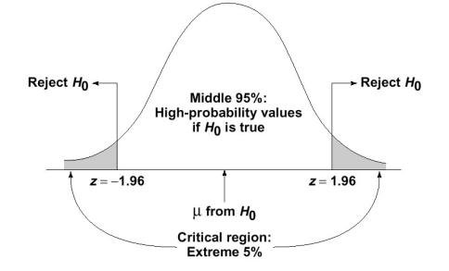
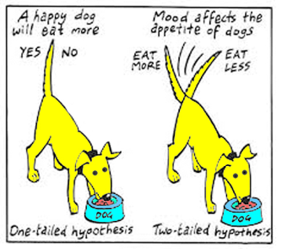
One-Tailed and Two-Tailed Tests
A test of a statistical hypothesis, where the region of rejection is on only one side of the sampling distribution, is called a one-tailed test.
A test of a statistical hypothesis, where the region of rejection is on both sides of the sampling distribution, is called a two-tailed test.

Slide 41
Power of a Hypothesis Test
The probability of not committing a Type II error is called the power of a hypothesis test.
Effect Size
To compute the power of the test, one offers an alternative view about the "true" value of the population parameter, assuming that the null hypothesis is false. The effect size is the difference between the true value and the value specified in the null hypothesis.
Effect size = True value - Hypothesized value
For example, suppose the null hypothesis states that a population mean is equal to 100. A researcher might ask: What is the probability of rejecting the null hypothesis if the true population mean is equal to 90?
In this example, the effect size would be 90 - 100, which equals -10.

Slide 42
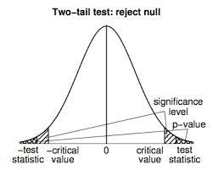
Factors That Affect Power
The power of a hypothesis test is affected by three factors.
Sample size (n). Other things being equal, the greater the sample size, the greater the power of the test.
Significance level (α). The higher the significance level, the higher the power of the test. If you increase the significance level, you reduce the region of acceptance. As a result, you are more likely to reject the null hypothesis. This means you are less likely to accept the null hypothesis when it is false; i.e., less likely to make a Type II error. Hence, the power of the test is increased.
The "true" value of the parameter being tested. The greater the difference between the "true" value of a parameter and the value specified in the null hypothesis, the greater the power of the test. That is, the greater the effect size, the greater the power of the test.

Slide 43
Problem
Suppose a researcher conducts an experiment to test a hypothesis. If she doubles her sample size, which of the following will increase?
I. The power of the hypothesis test. II. The effect size of the hypothesis test. III. The probability of making a Type II error.
(A) I only (B) II only (C) III only (D) All of the above (E) None of the above
Solution
The correct answer is (A). Increasing sample size makes the hypothesis test more sensitive - more likely to reject the null hypothesis when it is, in fact, false. Thus, it increases the power of the test.
The effect size is not affected by sample size. And the probability of making a Type II error gets smaller, not bigger, as sample size increases.

Slide 44

One Sample t -test
A supplier of a part to a large organization claims that the mean weight of this part is 90 grams. The organization took a small sample of 20 parts and found that the mean score is 84 grams and standard deviation is 11. Could this sample originate from a population of mean = 90 grams?
The organization wants to test this at significance level of 0.05, i.e., it is willing to take only a 5 percent risk of being wrong when it says the sample is not from the population. Therefore:
Null Hypothesis (H0): “True Population Mean Score is 90” Alternative Hypothesis (Ha): “True Population Mean Score is not 90” Alpha is 0.05
Farther away the observed or measured sample mean is from the hypothesized mean, the lower the probability (i.e., the p-value) that the null hypothesis is true. However, what is far enough?

Slide 45
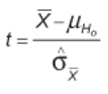


In this example, the difference between the sample mean and the hypothesized population mean is 6. Is that difference big enough to reject H0? In order to answer the question, the sample mean needs to be standardized and the so-called t-statistics or t-value need to be calculated.
In this formula, is the standard error of the mean (SE mean). Because the population standard deviation is not known, we have to estimate the SE mean. It can be estimated by the following equation:

Slide 46
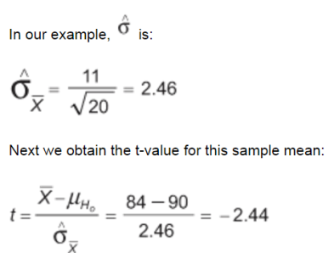
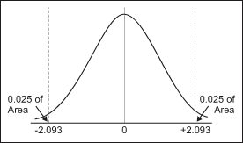
Finally, this t-value must be compared with the critical value of t. The critical t-value marks the threshold that – if it is exceeded – leads to the conclusion that the difference between the observed sample mean and the hypothesized population mean is large enough to reject H0. The critical t-value equals the value whose probability of occurrence is less or equal to 5 percent. From the t-distribution tables, one can find that the critical value of t is +/- 2.093.
Since the retrieved t-value of -2.44 is smaller than the critical value of -2.093, the null hypothesis must be rejected (i.e., the sample mean is not from the hypothesized population) and the supplier’s claims must be questioned.

Slide 47
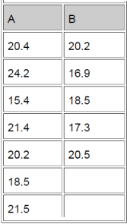
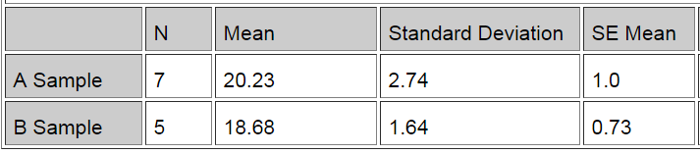
The Two-Sample T-Test
The question being answered is whether there is a significant (or only random) difference in the average cycle time to deliver a pizza from Pizza Company A vs. Pizza Company B. This is the data collected from a sample of deliveries of Company A and Company B.

Slide 48
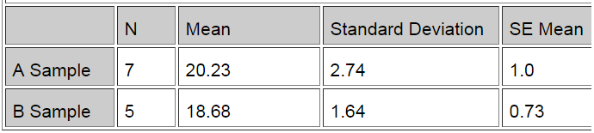
Difference = mu (A Sample) – mu (B Sample) Estimate for difference: 1.54857 95% CI for difference: (-1.53393, 4.63107) T-test of difference = 0 (vs not =): T-value = 1.12, P-value = 0.289, DF = 10 Both use pooled StDev = 2.3627
Since the p-value is 0.289, i.e. greater than 0.05 (or 5 percent), it can be concluded that there is no difference between the means. To say that there is a difference is taking a 28.9 percent risk of being wrong.

Slide 49

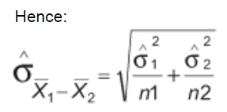
The Two-Sample T-Test
In the two-sample t-test, two sample means are compared to discover whether they come from the same population (meaning there is no difference between the two population means).
Now, because the question is whether two populations are actually one and the same, the first step is to obtain the SE mean from the sampling distribution of the difference between two sample means.
Again, since the population standard deviations of both of the two populations are unknown, the standard error of the two sample means must be estimated.
In the one-sample t-test, the SE mean was computed as such:

Slide 50
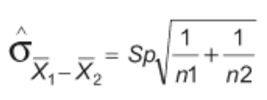
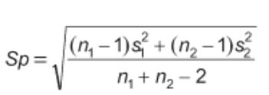
However, this is only appropriate when samples are large (both greater than 30). Where samples are smaller, use the following method:
Sp is a pooled estimate of the common population standard deviation. Hence, in this method it can be assumed that variances are equal for both populations. If it cannot be assumed, it cannot be used.

Slide 51
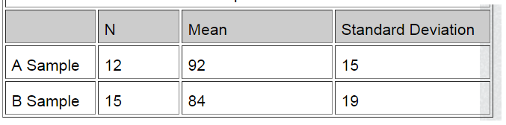
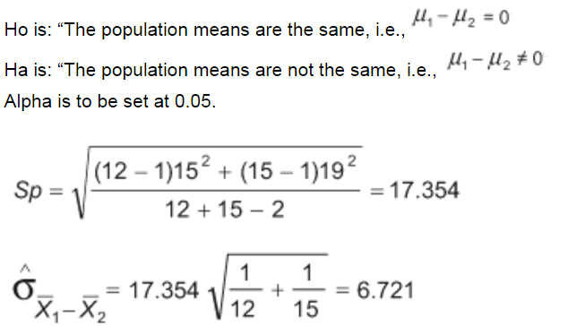
The Two-Sample T-Test

Slide 52

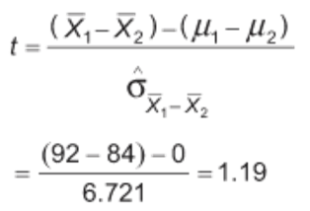
The Two-Sample T-Test
In the two-sample t-test, the t-statistics are retrieved by subtracting the difference between the two sample means from the null hypothesis, which is zero.
Looking up t-tables (using spreadsheet software, such as Excel’s TINV function, is easiest), one finds that the critical value of t is 2.06. Again, this means that if the standardized difference between the two sample means (and that is exactly what the t value indicates) is larger than 2.06, it can be concluded that there is a significant difference between population means.
Here, 1.19 is less than 2.06; thus, it is the null hypothesis that = 0.

Slide 53
Hypothesis Test for a Proportion
Problem 1: Two-Tailed Test
The CEO of a large electric utility claims that 80 percent of his 1,000,000 customers are very satisfied with the service they receive. To test this claim, the local newspaper surveyed 100 customers, using simple random sampling. Among the sampled customers, 73 percent say they are very satisified. Based on these findings, can we reject the CEO's hypothesis that 80% of the customers are very satisfied? Use a 0.05 level of significance.
Solution: The solution to this problem takes four steps: (1) state the hypotheses, (2) formulate an analysis plan, (3) analyze sample data, and (4) interpret results. We work through those steps below:
State the hypotheses. The first step is to state the null hypothesis and an alternative hypothesis.
Null hypothesis: P = 0.80 Alternative hypothesis: P ≠ 0.80
Note that these hypotheses constitute a two-tailed test. The null hypothesis will be rejected if the sample proportion is too big or if it is too small.

Slide 54
Hypothesis Test for a Proportion cont..
Formulate an analysis plan. For this analysis, the significance level is 0.05. The test method, shown in the next section, is a one-sample z-test.
Analyze sample data. Using sample data, we calculate the standard deviation (σ) and compute the z-score test statistic (z).
σ = sqrt[ P * ( 1 - P ) / n ] = sqrt [(0.8 * 0.2) / 100] = sqrt(0.0016) = 0.04 z = (p - P) / σ = (.73 - .80)/0.04 = -1.75
where P is the hypothesized value of population proportion in the null hypothesis, p is the sample proportion, and n is the sample size.
Since we have a two-tailed test, the P-value is the probability that the z-score is less than -1.75 or greater than 1.75.
We use the Normal Distribution Calculator to find P(z < -1.75) = 0.04, and P(z > 1.75) = 0.04. Thus, the P-value = 0.04 + 0.04 = 0.08.
Interpret results. Since the P-value (0.08) is greater than the significance level (0.05), we cannot reject the null hypothesis.

Slide 55
Hypothesis Test for a Proportion cont..
Problem 2: One-Tailed Test
Suppose the previous example is stated a little bit differently.
Suppose the CEO claims that at least 80 percent of the company's 1,000,000 customers are very satisfied. Again, 100 customers are surveyed using simple random sampling. The result: 73 percent are very satisfied. Based on these results, should we accept or reject the CEO's hypothesis? Assume a significance level of 0.05.
State the hypotheses. The first step is to state the null hypothesis and an alternative hypothesis.
Null hypothesis: P >= 0.80 Alternative hypothesis: P < 0.80
Note that these hypotheses constitute a one-tailed test. The null hypothesis will be rejected only if the sample proportion is too small.

Slide 56
Hypothesis Test for a Proportion cont..
Formulate an analysis plan. For this analysis, the significance level is 0.05. The test method, shown in the next section, is a one-sample z-test.
Analyze sample data. Using sample data, we calculate the standard deviation (σ) and compute the z-score test statistic (z).
σ = sqrt[ P * ( 1 - P ) / n ] = sqrt [(0.8 * 0.2) / 100] = sqrt(0.0016) = 0.04 z = (p - P) / σ = (.73 - .80)/0.04 = -1.75
where P is the hypothesized value of population proportion in the null hypothesis, p is the sample proportion, and n is the sample size.
Since we have a one-tailed test, the P-value is the probability that the z-score is less than -1.75. We use the Normal Distribution Calculator to find P(z < -1.75) = 0.04. Thus, the P-value = 0.04.
Interpret results. Since the P-value (0.04) is less than the significance level (0.05), we cannot accept the null hypothesis.

Slide 57
Hypothesis Test: Difference Between Proportions
Problem 1: Two-Tailed Test
Suppose the Acme Drug Company develops a new drug, designed to prevent colds. The company states that the drug is equally effective for men and women. To test this claim, they choose a a simple random sample of 100 women and 200 men from a population of 100,000 volunteers.
At the end of the study, 38% of the women caught a cold; and 51% of the men caught a cold. Based on these findings, can we reject the company's claim that the drug is equally effective for men and women? Use a 0.05 level of significance.
Solution: The solution to this problem takes four steps: (1) state the hypotheses, (2) formulate an analysis plan, (3) analyze sample data, and (4) interpret results. We work through those steps below:
State the hypotheses. The first step is to state the null hypothesis and an alternative hypothesis.
Null hypothesis: P₁ = P₂ Alternative hypothesis: P₁ ≠ P₂
Note that these hypotheses constitute a two-tailed test. The null hypothesis will be rejected if the proportion from population 1 is too big or if it is too small.

Slide 58
Hypothesis Test: Difference Between Proportions cont..
Formulate an analysis plan. For this analysis, the significance level is 0.05. The test method is a two-proportion z-test.
Analyze sample data. Using sample data, we calculate the pooled sample proportion (p) and the standard error (SE). Using those measures, we compute the z-score test statistic (z).
p = (p₁ * n₁ + p₂ * n₂) / (n₁ + n₂) = [(0.38 * 100) + (0.51 * 200)] / (100 + 200) = 140/300 = 0.467 SE = sqrt{ p * ( 1 - p ) * [ (1/n₁) + (1/n₂) ] } SE = sqrt [ 0.467 * 0.533 * ( 1/100 + 1/200 ) ] = sqrt [0.003733] = 0.061 z = (p₁ - p₂) / SE = (0.38 - 0.51)/0.061 = -2.13
where p₁ is the sample proportion in sample 1, where p₂ is the sample proportion in sample 2, n₁ is the size of sample 1, and n₂ is the size of sample 2.
Since we have a two-tailed test, the P-value is the probability that the z-score is less than -2.13 or greater than 2.13.
We use the Normal Distribution Calculator to find P(z < -2.13) = 0.017, and P(z > 2.13) = 0.017. Thus, the P-value = 0.017 + 0.017 = 0.034.
Interpret results. Since the P-value (0.034) is less than the significance level (0.05), we cannot accept the null hypothesis.

Slide 59
Hypothesis Test for a Mean
Problem 1: Two-Tailed Test
An inventor has developed a new, energy-efficient lawn mower engine. He claims that the engine will run continuously for 5 hours (300 minutes) on a single gallon of regular gasoline. From his stock of 2000 engines, the inventor selects a simple random sample of 50 engines for testing. The engines run for an average of 295 minutes, with a standard deviation of 20 minutes. Test the null hypothesis that the mean run time is 300 minutes against the alternative hypothesis that the mean run time is not 300 minutes. Use a 0.05 level of significance. (Assume that run times for the population of engines are normally distributed.)
State the hypotheses. The first step is to state the null hypothesis and an alternative hypothesis.
Null hypothesis: μ = 300 Alternative hypothesis: μ ≠ 300
Note that these hypotheses constitute a two-tailed test. The null hypothesis will be rejected if the sample mean is too big or if it is too small.
Formulate an analysis plan. For this analysis, the significance level is 0.05. The test method is a one-sample t-test.

Slide 60
Hypothesis Test for a Mean
Analyze sample data. Using sample data, we compute the standard error (SE), degrees of freedom (DF), and the t statistic test statistic (t).
SE = s / sqrt(n) = 20 / sqrt(50) = 20/7.07 = 2.83 DF = n - 1 = 50 - 1 = 49 t = (x - μ) / SE = (295 - 300)/2.83 = -1.77
where s is the standard deviation of the sample, x is the sample mean, μ is the hypothesized population mean, and n is the sample size.
Since we have a two-tailed test, the P-value is the probability that the t statistic having 49 degrees of freedom is less than -1.77 or greater than 1.77.
We use the t Distribution Calculator to find P(t < -1.77) = 0.04, and P(t > 1.77) = 0.04.
Thus, the P-value = 0.04 + 0.04 = 0.08.
Interpret results. Since the P-value (0.08) is greater than the significance level (0.05), we cannot reject the null hypothesis.
Note: If you use this approach on an exam, you may also want to mention why this approach is appropriate. Specifically, the approach is appropriate because the sampling method was simple random sampling, the population was normally distributed, and the sample size was small relative to the population size (less than 5%).

Slide 61
Hypothesis Test for a Mean
Problem 2: One-Tailed Test Bon Air Elementary School has 1000 students. The principal of the school thinks that the average IQ of students at Bon Air is at least 110. To prove her point, she administers an IQ test to 20 randomly selected students. Among the sampled students, the average IQ is 108 with a standard deviation of 10. Based on these results, should the principal accept or reject her original hypothesis? Assume a significance level of 0.01. (Assume that test scores in the population of engines are normally distributed.)
Null hypothesis: μ >= 110 Alternative hypothesis: μ < 110
Formulate an analysis plan. For this analysis, the significance level is 0.01. The test method is a one-sample t-test.

Slide 62
Hypothesis Test for a Mean
Analyze sample data. Using sample data, we compute the standard error (SE), degrees of freedom (DF), and the t statistic test statistic (t).
SE = s / sqrt(n) = 10 / sqrt(20) = 10/4.472 = 2.236 DF = n - 1 = 20 - 1 = 19 t = (x - μ) / SE = (108 - 110)/2.236 = -0.894
where s is the standard deviation of the sample, x is the sample mean, μ is the hypothesized population mean, and n is the sample size.
Here is the logic of the analysis: Given the alternative hypothesis (μ < 110), we want to know whether the observed sample mean is small enough to cause us to reject the null hypothesis.
The observed sample mean produced a t statistic test statistic of -0.894. We use the t Distribution Calculator to find P(t < -0.894) = 0.19. This means we would expect to find a sample mean of 108 or smaller in 19 percent of our samples, if the true population IQ were 110. Thus the P-value in this analysis is 0.19.
Interpret results. Since the P-value (0.19) is greater than the significance level (0.01), we cannot reject the null hypothesis.

Slide 63
Hypothesis Test: Difference Between Means
Problem 1: Two-Tailed Test
Within a school district, students were randomly assigned to one of two Math teachers - Mrs. Smith and Mrs. Jones. After the assignment, Mrs. Smith had 30 students, and Mrs. Jones had 25 students.
At the end of the year, each class took the same standardized test. Mrs. Smith's students had an average test score of 78, with a standard deviation of 10; and Mrs. Jones' students had an average test score of 85, with a standard deviation of 15.
Test the hypothesis that Mrs. Smith and Mrs. Jones are equally effective teachers. Use a 0.10 level of significance. (Assume that student performance is approximately normal.)
State the hypotheses. The first step is to state the null hypothesis and an alternative hypothesis.
Null hypothesis: μ₁ - μ₂ = 0 Alternative hypothesis: μ₁ - μ₂ ≠ 0
Note that these hypotheses constitute a two-tailed test. The null hypothesis will be rejected if the difference between sample means is too big or if it is too small.

Slide 64
Hypothesis Test: Difference Between Means
Formulate an analysis plan. For this analysis, the significance level is 0.10. Using sample data, we will conduct a two-sample t-test of the null hypothesis.
Analyze sample data. Using sample data, we compute the standard error (SE), degrees of freedom (DF), and the t statistic test statistic (t).
SE = sqrt[(s₁²/n₁) + (s₂²/n₂)] SE = sqrt[(10²/30) + (15²/25] = sqrt(3.33 + 9) = sqrt(12.33) = 3.51 DF = (s₁²/n₁ + s₂²/n₂)² / { [ (s₁² / n₁)² / (n₁ - 1) ] + [ (s₂² / n₂)² / (n₂ - 1) ] } DF = (10²/30 + 15²/25)² / { [ (10² / 30)² / (29) ] + [ (15² / 25)² / (24) ] } DF = (3.33 + 9)² / { [ (3.33)² / (29) ] + [ (9)² / (24) ] } = 152.03 / (0.382 + 3.375) = 152.03/3.757 = 40.47 t = [ (x₁ - x₂) - d ] / SE = [ (78 - 85) - 0 ] / 3.51 = -7/3.51 = -1.99
where s₁ is the standard deviation of sample 1, s₂ is the standard deviation of sample 2, n₁ is the size of sample 1, n₂ is the size of sample 2, x₁ is the mean of sample 1, x₂ is the mean of sample 2, d is the hypothesized difference between the population means, and SE is the standard error.
Since we have a two-tailed test, the P-value is the probability that a t statistic having 40 degrees of freedom is more extreme than -1.99; that is, less than -1.99 or greater than 1.99.
We use the t Distribution Calculator to find P(t < -1.99) = 0.027, and P(t > 1.99) = 0.027. Thus, the P-value = 0.027 + 0.027 = 0.054.
Interpret results. Since the P-value (0.054) is less than the significance level (0.10), we cannot accept the null hypothesis.

Slide 65
Hypothesis Test: Difference Between Means
Problem 2: One-Tailed Test
The Acme Company has developed a new battery. The engineer in charge claims that the new battery will operate continuously for at least 7 minutes longer than the old battery.
To test the claim, the company selects a simple random sample of 100 new batteries and 100 old batteries. The old batteries run continuously for 190 minutes with a standard deviation of 20 minutes; the new batteries, 200 minutes with a standard deviation of 40 minutes.
Test the engineer's claim that the new batteries run at least 7 minutes longer than the old. Use a 0.05 level of significance. (Assume that there are no outliers in either sample.)
State the hypotheses. The first step is to state the null hypothesis and an alternative hypothesis.
Null hypothesis: μ₁ - μ₂ >= 7 Alternative hypothesis: μ₁ - μ₂ < 7
Note that these hypotheses constitute a one-tailed test. The null hypothesis will be rejected if the mean difference between sample means is too small.

Slide 66
Hypothesis Test: Difference Between Means
Formulate an analysis plan. For this analysis, the significance level is 0.05.
Analyze sample data. Using sample data, we compute the standard error (SE), degrees of freedom (DF), and the t statistic test statistic (t).
SE = sqrt[(s₁²/n₁) + (s₂²/n₂)] SE = sqrt[(40²/100) + (20²/100] = sqrt(16 + 4) = 4.472 DF = (s₁²/n₁ + s₂²/n₂)² / { [ (s₁² / n₁)² / (n₁ - 1) ] + [ (s₂² / n₂)² / (n₂ - 1) ] } DF = (40²/100 + 20²/100)² / { [ (40² / 100)² / (99) ] + [ (20² / 100)² / (99) ] } DF = (20)² / { [ (16)² / (99) ] + [ (2)² / (99) ] } = 400 / (2.586 + 0.162) = 145.56 t = [ (x₁ - x₂) - d ] / SE = [(200 - 190) - 7] / 4.472 = 3/4.472 = 0.67
where s₁ is the standard deviation of sample 1, s₂ is the standard deviation of sample 2, n₁ is the size of sample 1, n₂ is the size of sample 2, x₁ is the mean of sample 1, x₂ is the mean of sample 2, d is the hypothesized difference between population means, and SE is the standard error.

Slide 67
Hypothesis Test: Difference Between Means
Here is the logic of the analysis: Given the alternative hypothesis (μ₁ - μ₂ < 7), we want to know whether the observed difference in sample means is small enough (i.e., sufficiently less than 7) to cause us to reject the null hypothesis.
The observed difference in sample means (10) produced a t statistic of 0.67. We use the t Distribution Calculator to find P(t < 0.67) = 0.75.
This means we would expect to find an observed difference in sample means of 10 or less in 75% of our samples, if the true difference were actually 7. Therefore, the P-value in this analysis is 0.75.
Interpret results. Since the P-value (0.75) is greater than the significance level (0.05), we cannot reject the null hypothesis.

Slide 68
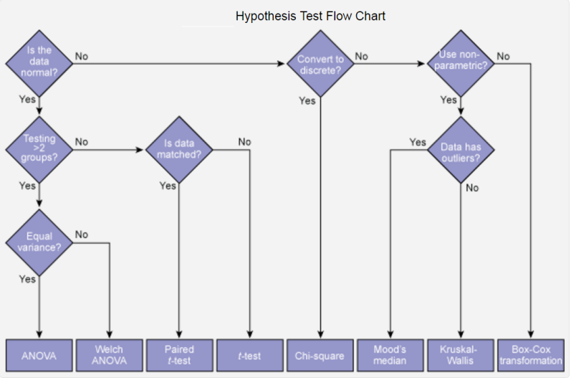
Hypothesis Test Flow Chart

Slide 69
What is a Z-test?
Learn more about Minitab 17
A Z-test is a hypothesis test based on the Z-statistic, which follows the standard normal distribution under the null hypothesis.
The simplest Z-test is the 1-sample Z-test, which tests the mean of a normally distributed population with known variance. For example, the manager of a candy manufacturer wants to know whether the mean weight of a batch of candy boxes is equal to the target value of 10 ounces. From historical data, they know that the filling machine has a standard deviation of 0.5 ounces, so they use this value as the population standard deviation in a 1-sample Z-test.
You can also use Z-tests to determine whether predictor variables in probit analysis and logistic regression have a significant effect on the response. The null hypothesis states that the predictor is not significant.
You also have the option to use a Z-test to do a normal approximation for tests of Poisson rate and tests of proportions. These normal approximations are valid when the sample size and the number of events are adequately large.

